Slide 1
Graduation Project Report
Subject:
Building an online e-commerce website
Tutor:
Nguyễn Thái Cường
Perform:
Group 2
Class:
BHAF2005-2.1

Slide 2
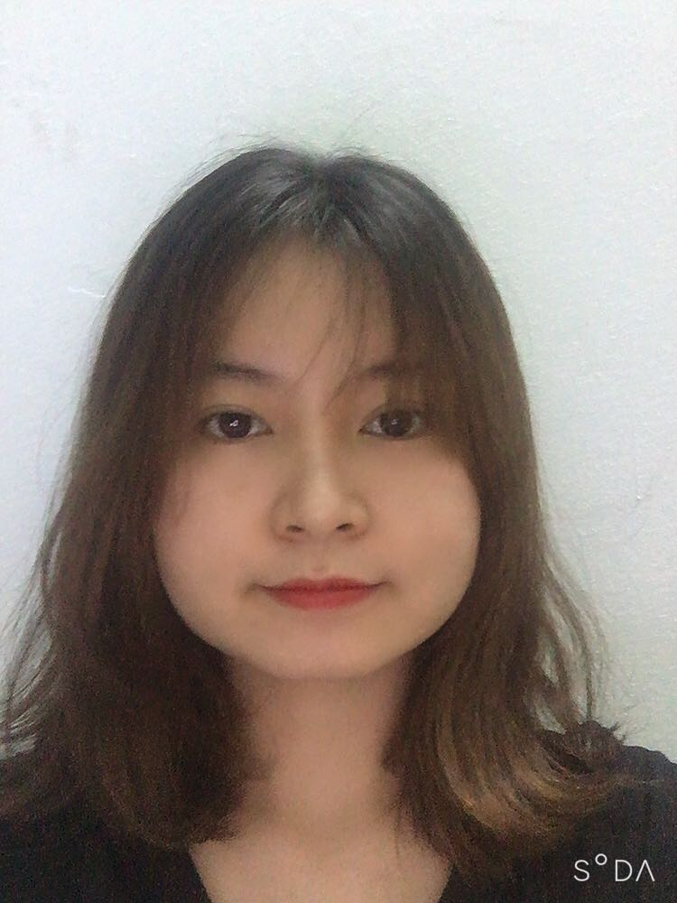

OUR TEAM
Trần Linh
Hoài Nam
Khoa Điềm
Phạm Tài
Leader: Assign tasks, back-up, write SRS, UI design, Test execute
Back-end, Front-end Developer
Front-end Developer
Write test cases, upload website on heroku

Slide 3
I.
PROBLEM
II.
CONDUCTING
TABLE OF CONTENTS
III.
CONCLUSION
IV.
DEMO WEBSITE

Slide 4
I.
PROBLEM

Slide 5
1. The reason for choosing the subject
Development trend of the market
Advantages of the Internet
Cost

Slide 6
2. Goals
Meet the needs of buying, searching for products, building a convenient and intuitive shopping environment, easy to manipulate with many users.
Help customers have a detailed view of the product, information about its characteristics
Shorten the distance between buyers and sellers.

Slide 7
II.
CONDUCTING

Slide 8
Content
1. System analysis and design
2. Coding and demo
3. Test and upload website to heroku

Slide 9
1. System analysis and design
1.1 Basic functions and Use case diagram

Slide 10
Basic functions
Guest
Customer
Admin
Manage Product
Manage Category
Manage Manufacturer
Manage User
Manage Rating/Review
Manage Order
Manage feedback
Purchase goods
Search product
Login
Register
Reset Password
Manage Shopping Cart
See product detail
Manage profile
Send feedback
See order history
Product review
Logout

Slide 11
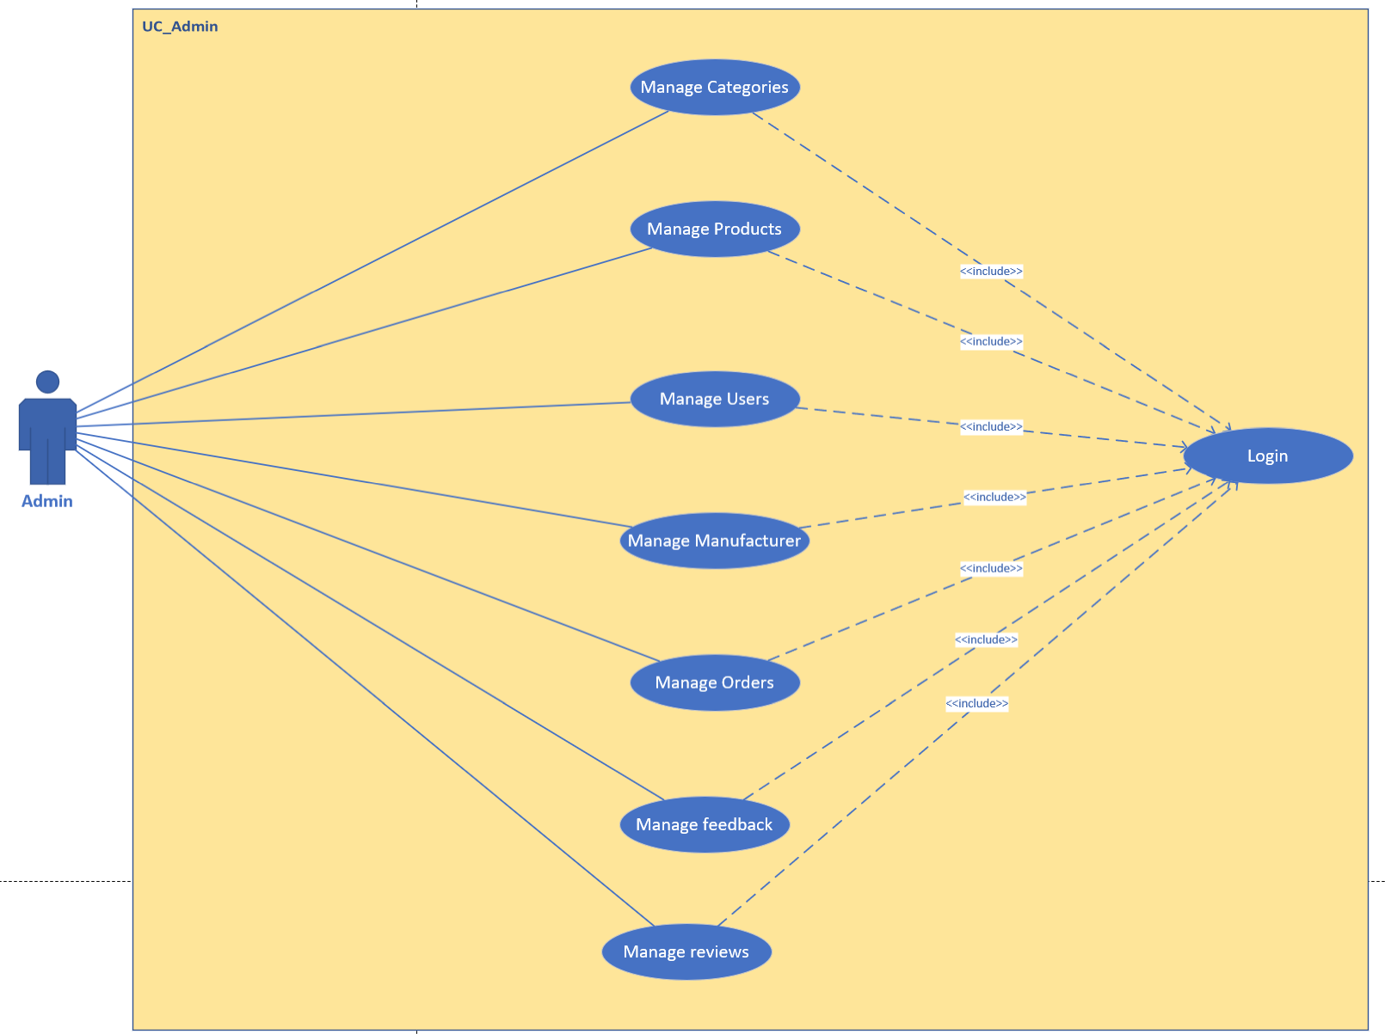
Admin_Use case diagram

Slide 12
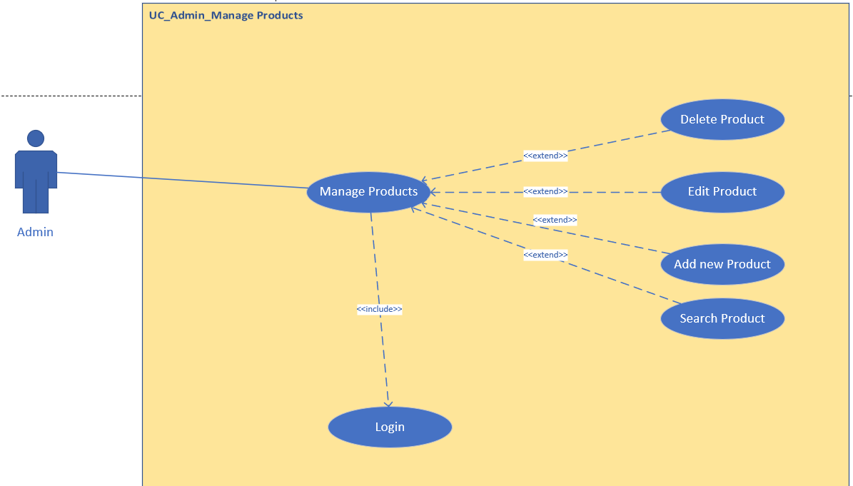
Admin_Use case diagram

Slide 13
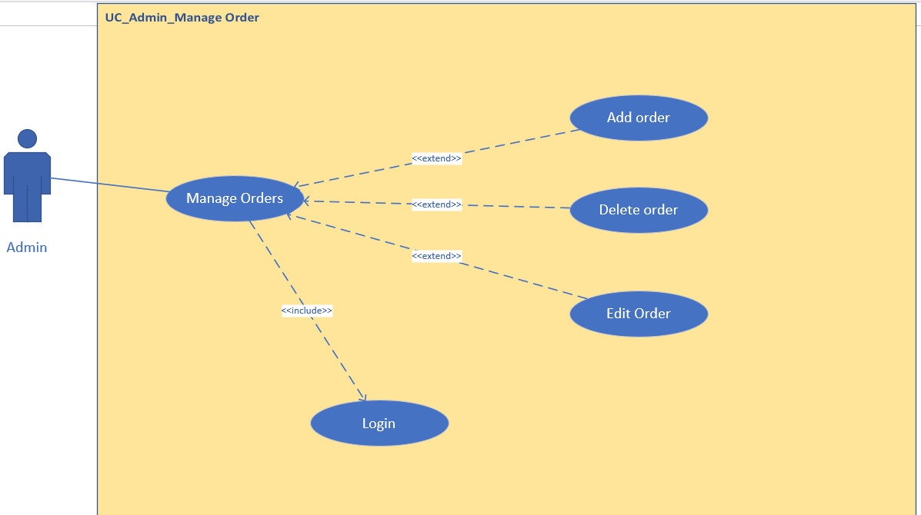
Admin_Use case diagram

Slide 14
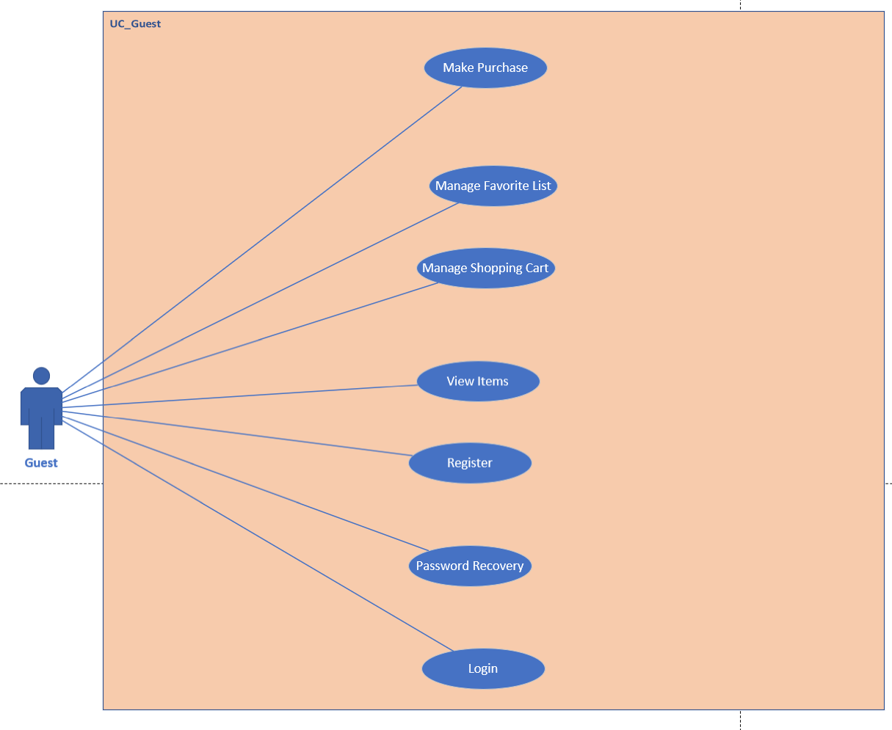
Guest_Use case diagram

Slide 15
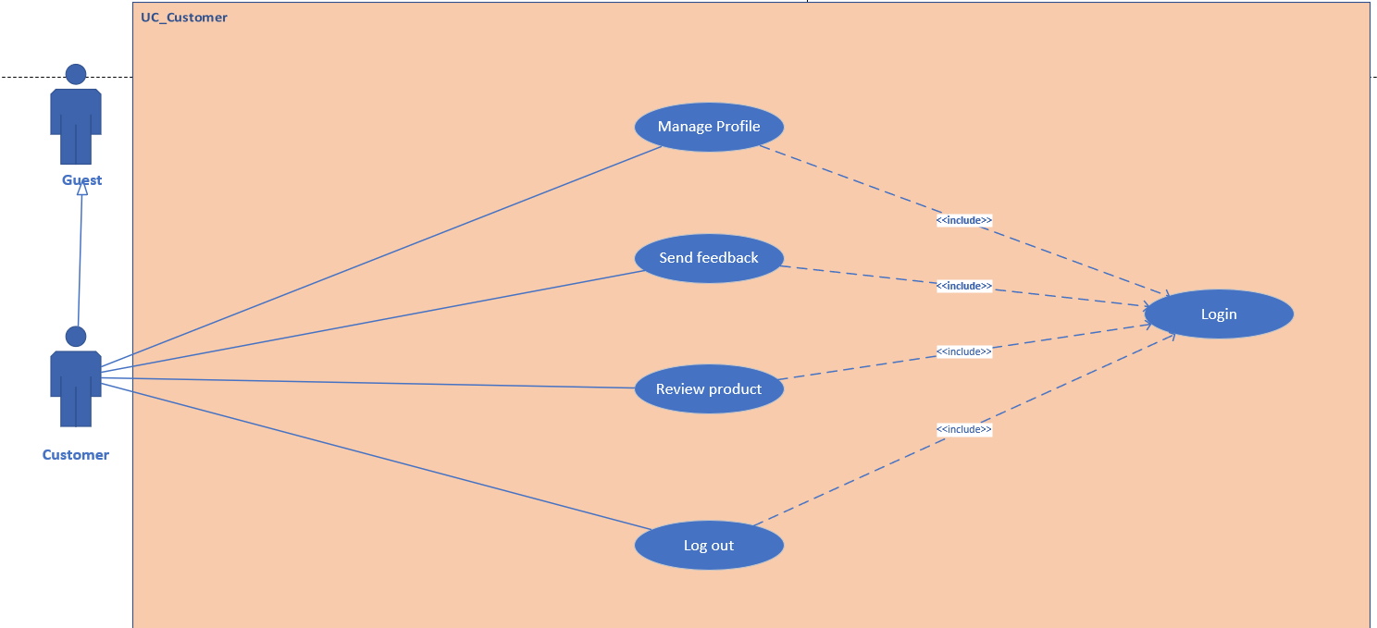
Customer_Use case diagram

Slide 16
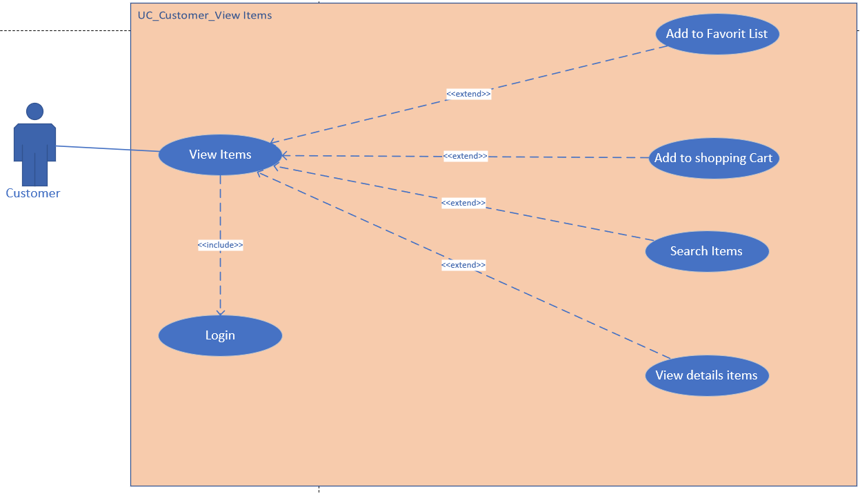
Customer_Use case diagram

Slide 17
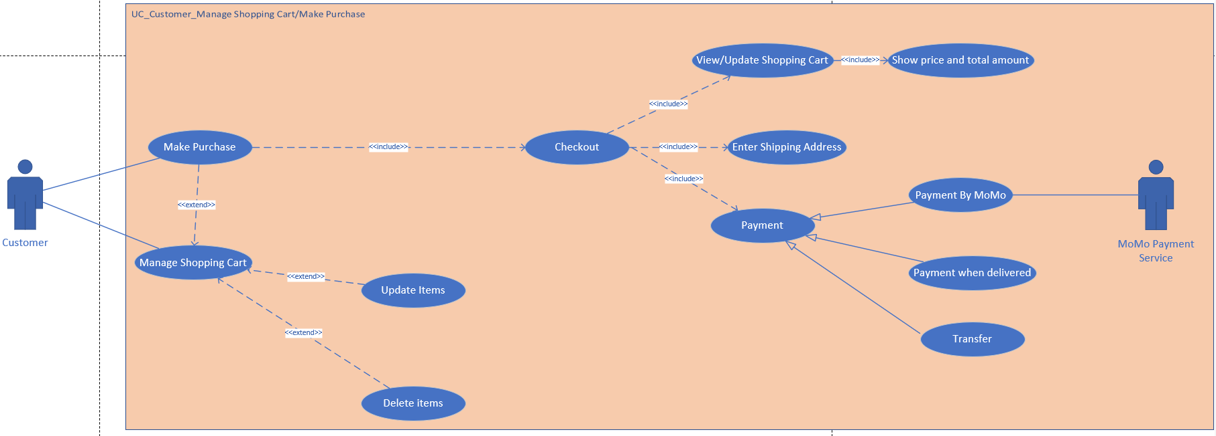
Customer_Use case diagram

Slide 18
1. System analysis and design
1.2 Activity diagram

Slide 19
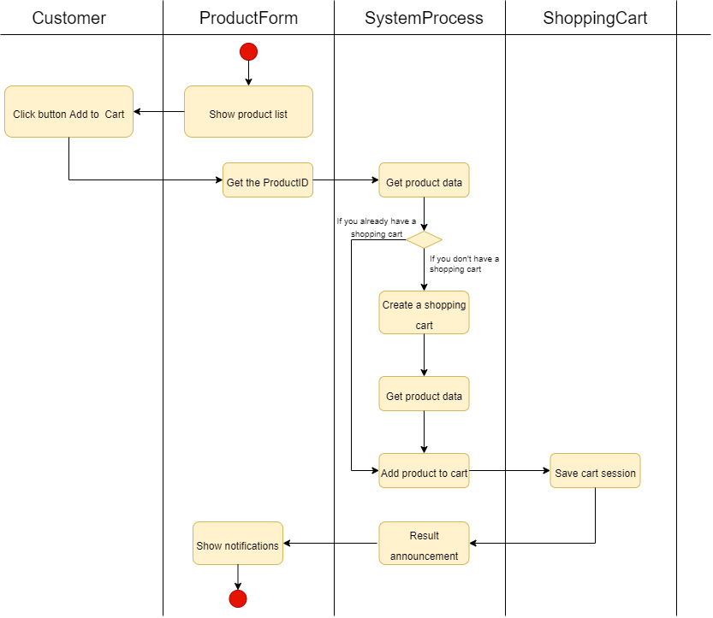
Add to cart activity

Slide 20
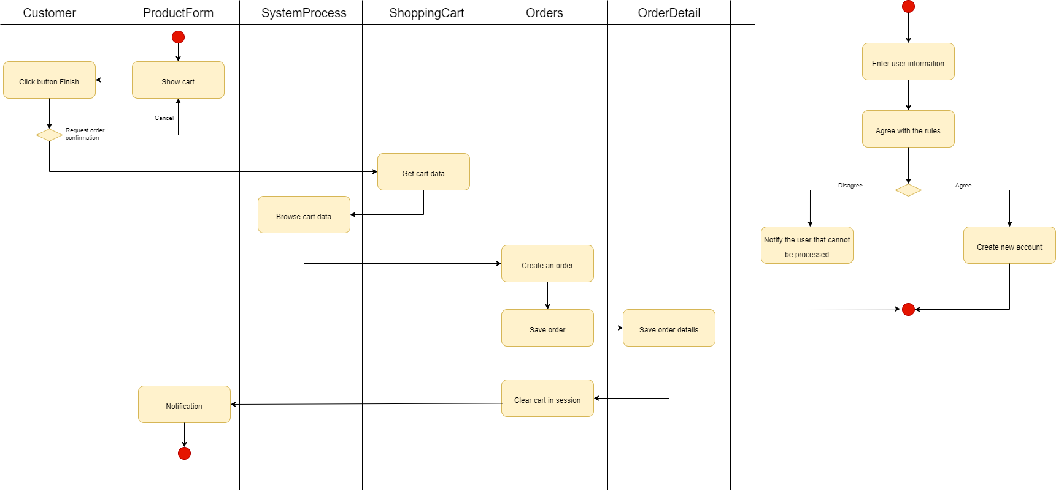
Invoice entry activity

Slide 21
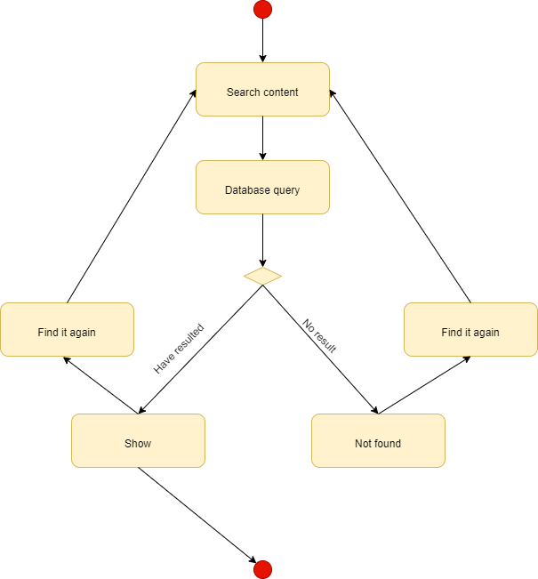
Purchasing and Payment Activity

Slide 22
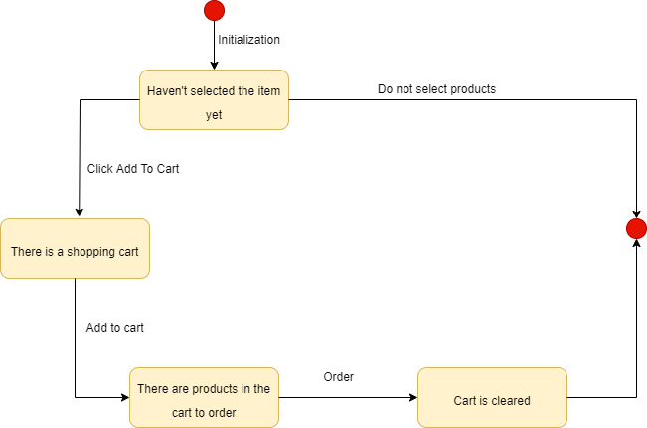
Cart Status Activity

Slide 23
1. System analysis and design
1.3 Sequence Diagram

Slide 24
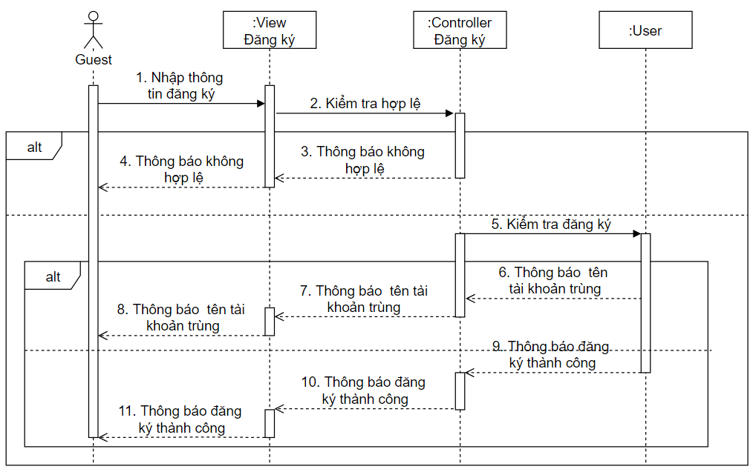
Sequence Diagram Register

Slide 25
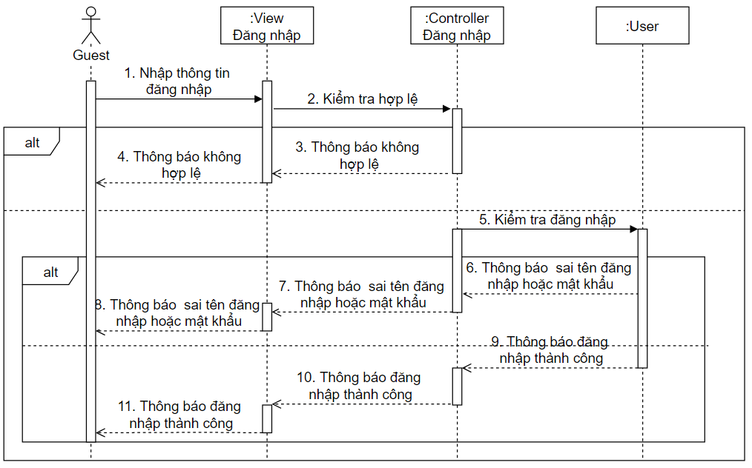
Sequence Diagram Log in

Slide 26
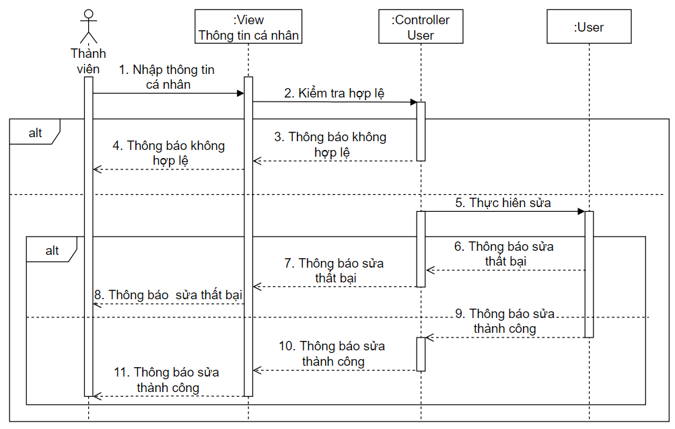
Sequential chart of correcting personal information

Slide 27
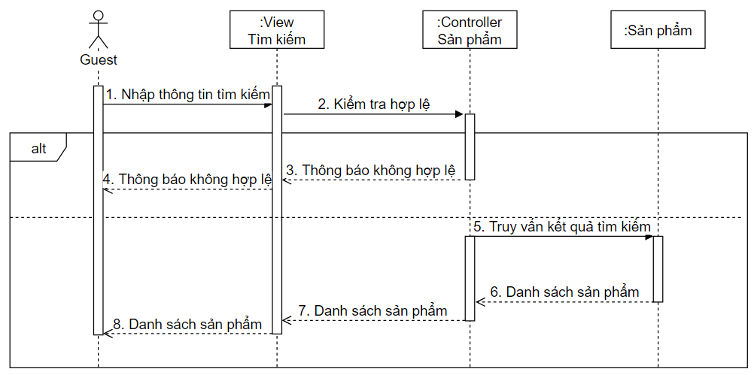
Sequence Diagram Search

Slide 28
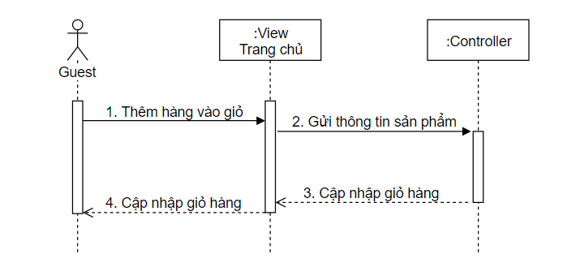
Sequence chart Add to cart

Slide 29
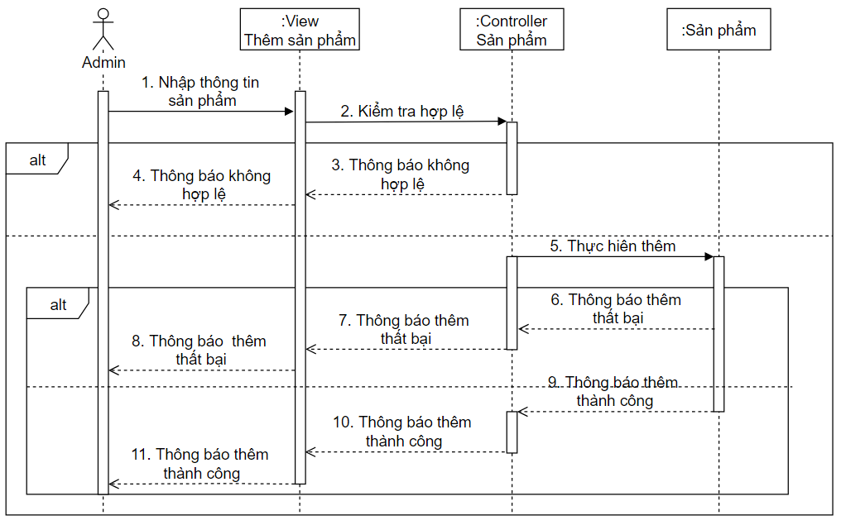
Sequence chart Add product

Slide 30
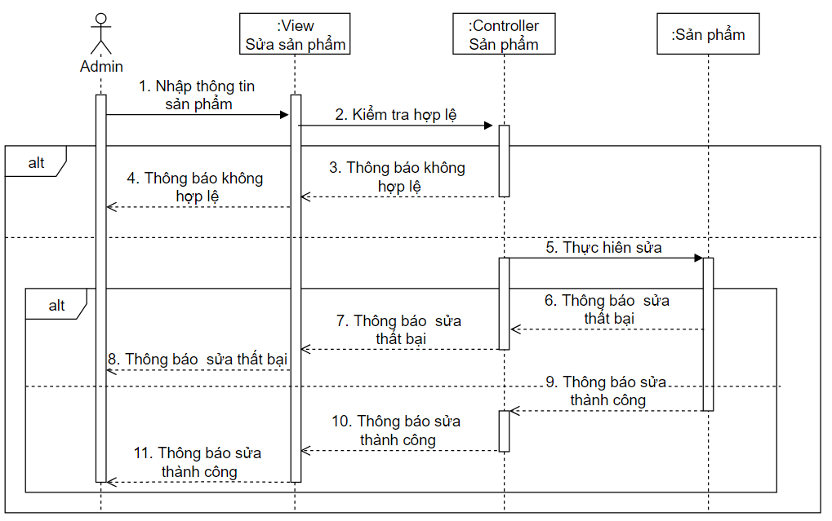
Sequence Diagram Edit Product

Slide 31
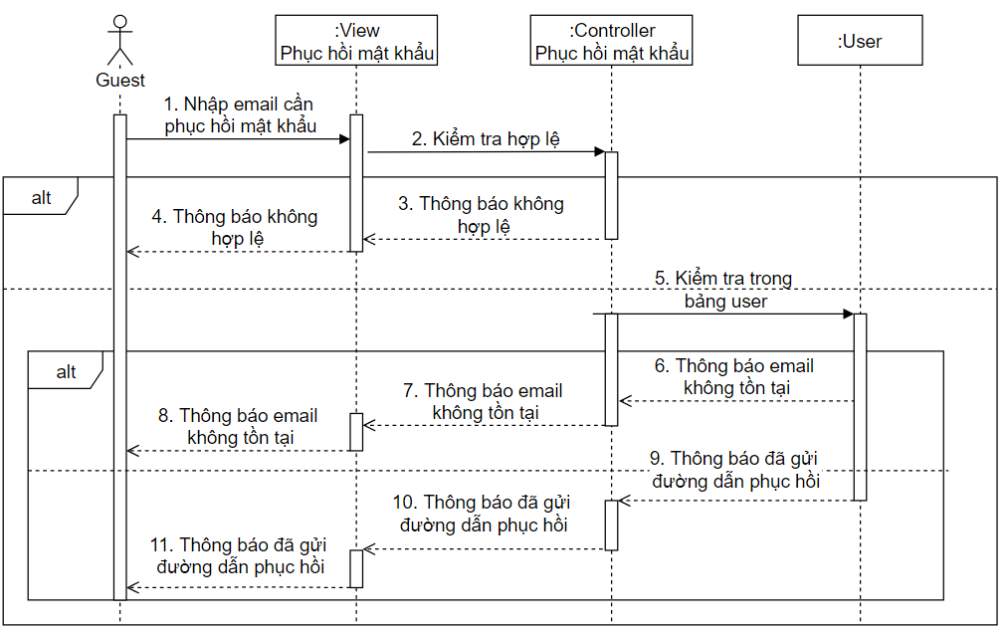
Sequence Diagram Password Recovery

Slide 32
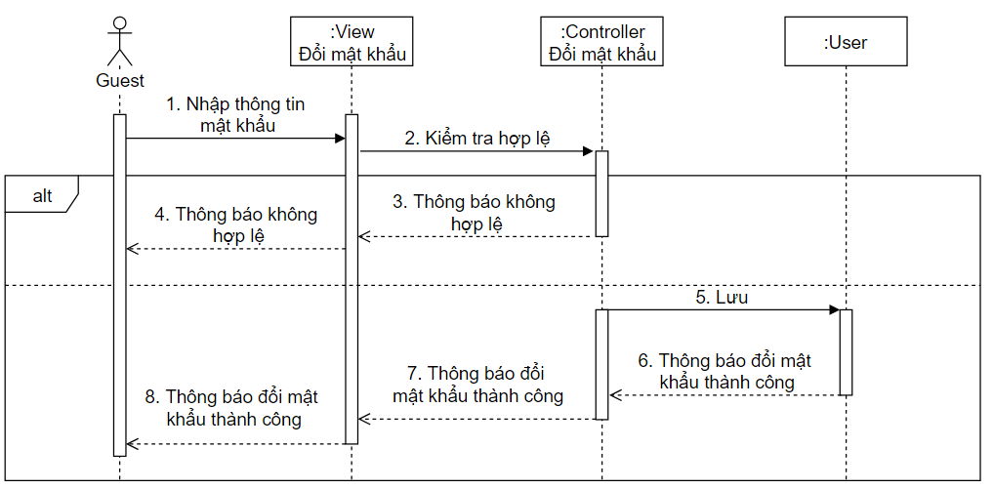
Sequential chart of password change

Slide 33
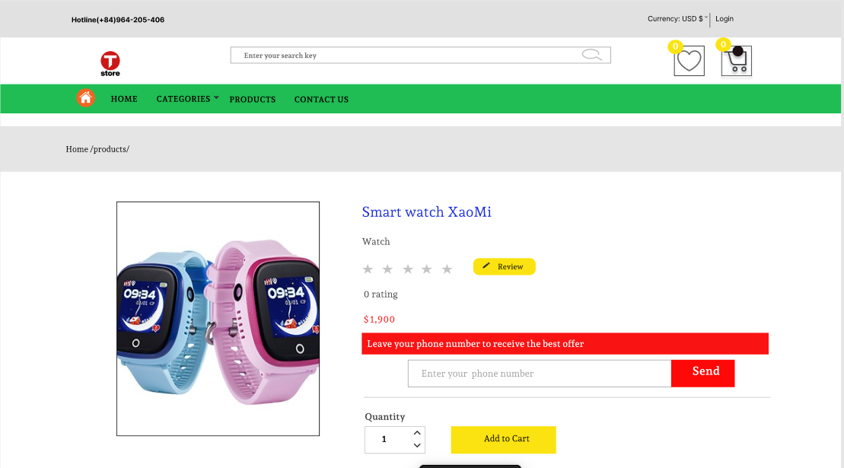
UI DESIGN
https://www.figma.com/file/CNU6ZMXfhH7IPry9XTVMV5/Graducation-project?node-id=0%3A1

Slide 34
2. Coding and Demo

Slide 35
2. Coding and Demo
2.1 Demo of Website Interface

Slide 36
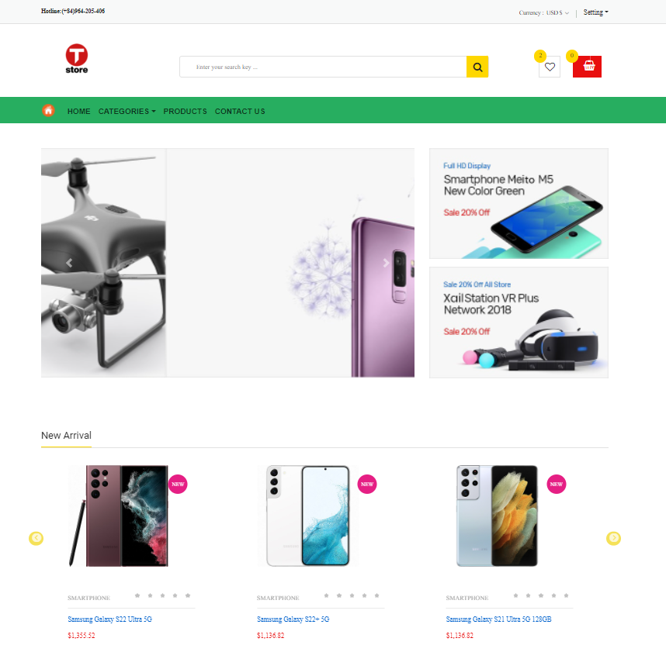
Home page interface

Slide 37
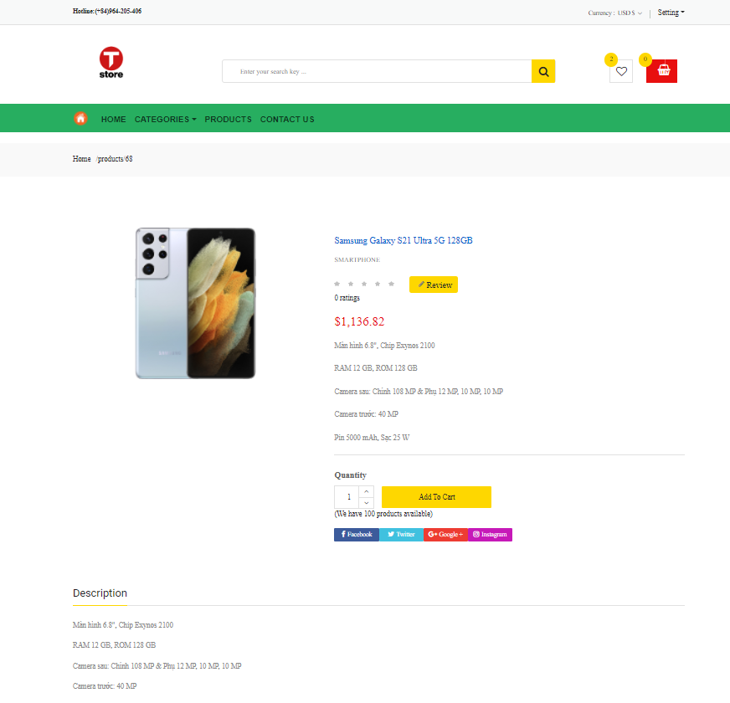
Product detail page interface

Slide 38
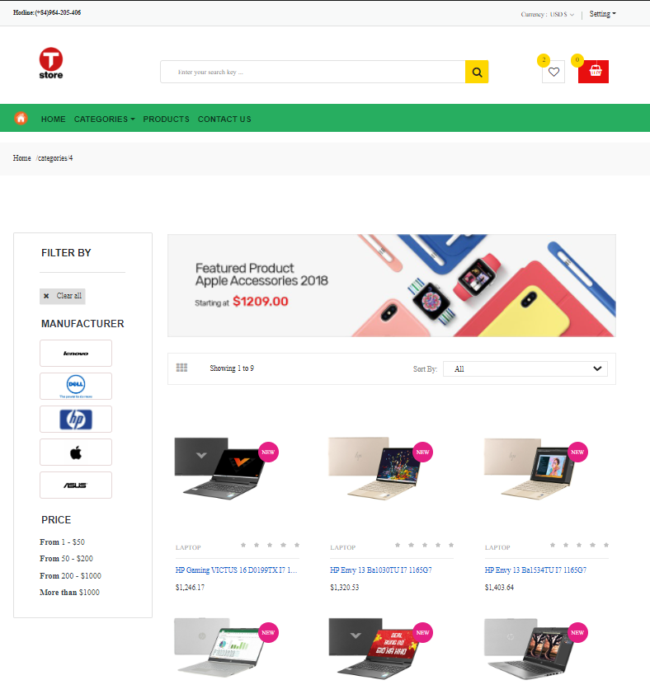
Product page interface

Slide 39
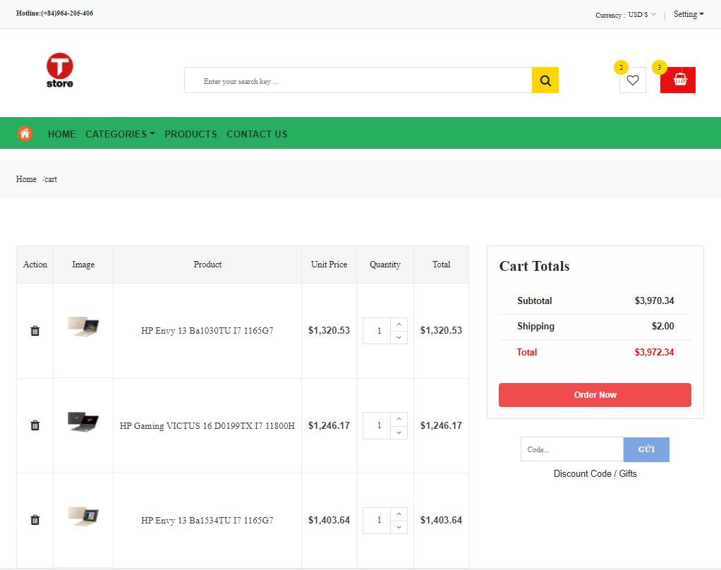
Cart page interface

Slide 40
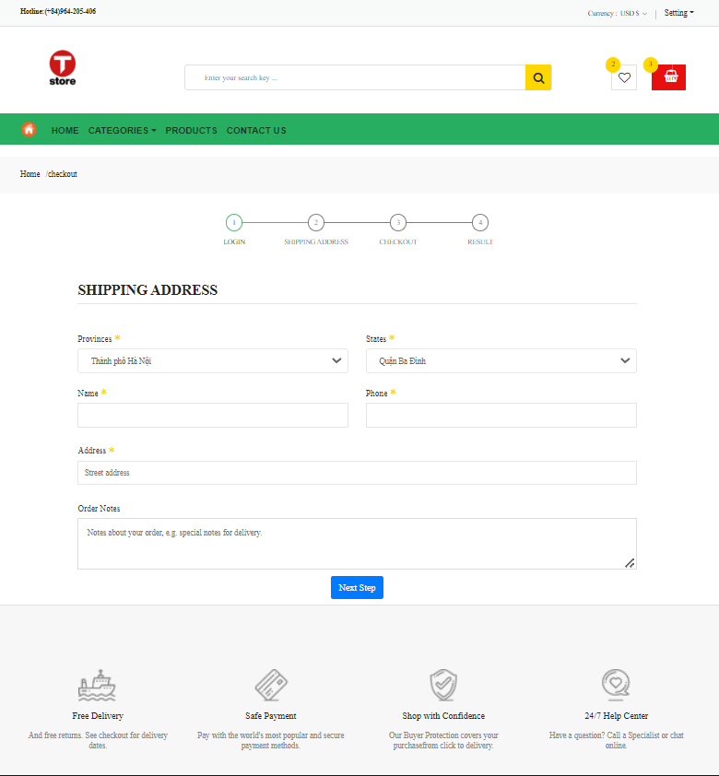
The interface of the page to fill in customer information to pay for the product

Slide 41
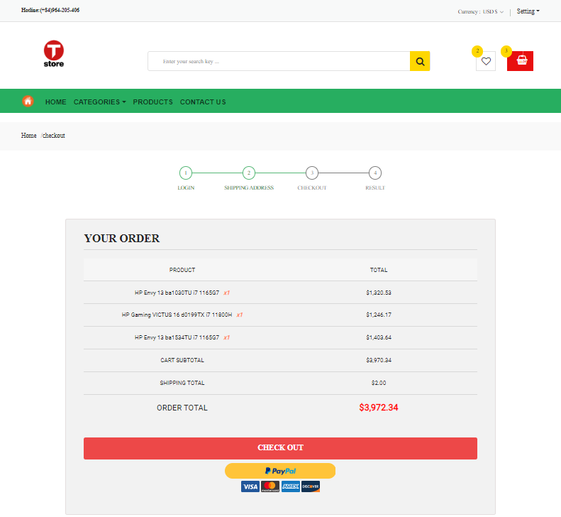
Payment page interface

Slide 42
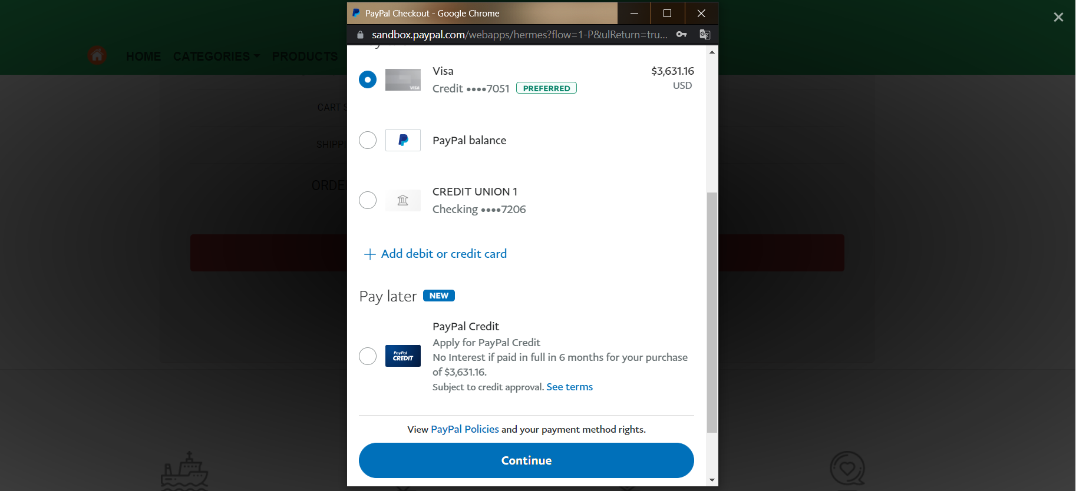
Payment page interface using payment gateway

Slide 43
2. Coding and Demo
2.1 Demo of Admin Pages

Slide 44
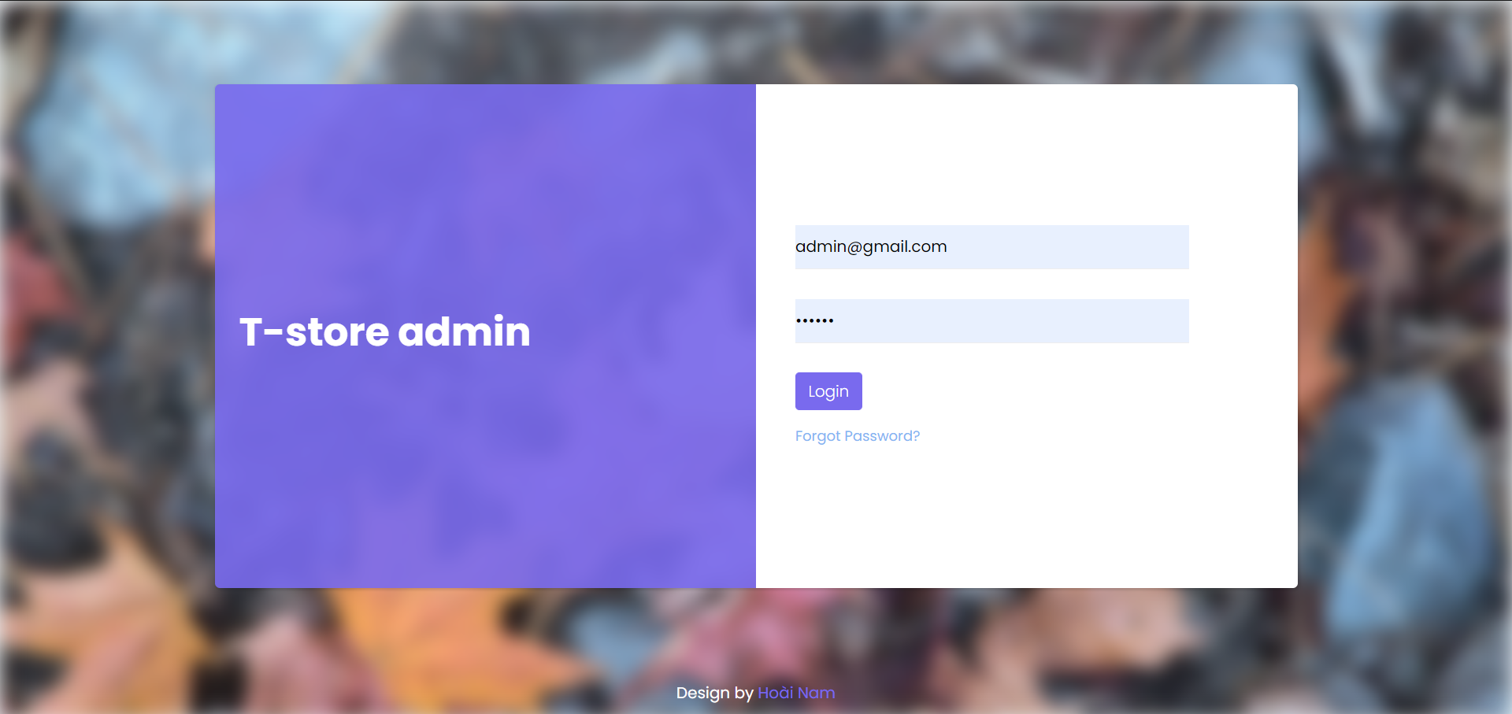
This is the login interface of the admin page

Slide 45
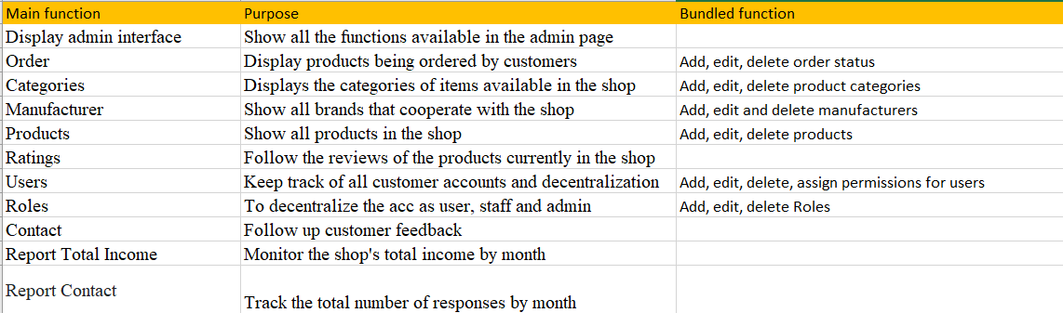
When logged in as admin, there will be the following functions:

Slide 46
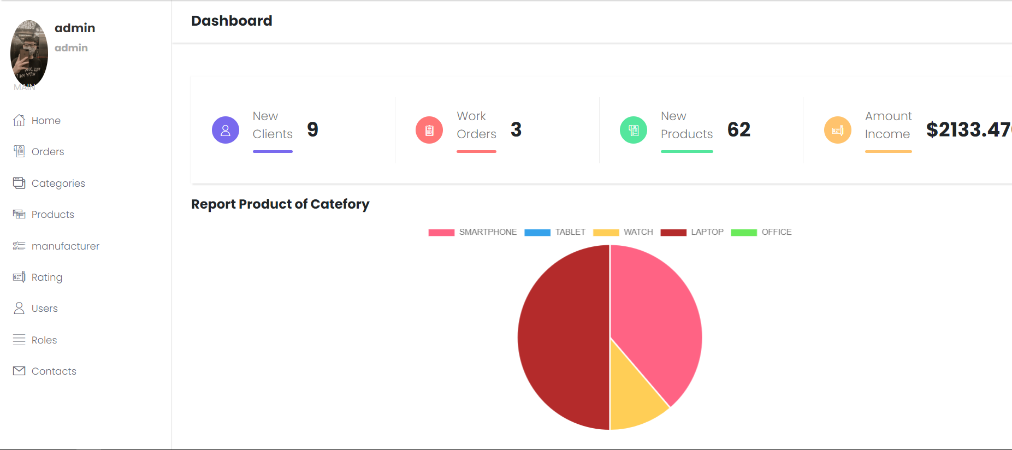
The main interface of the admin page

Slide 47
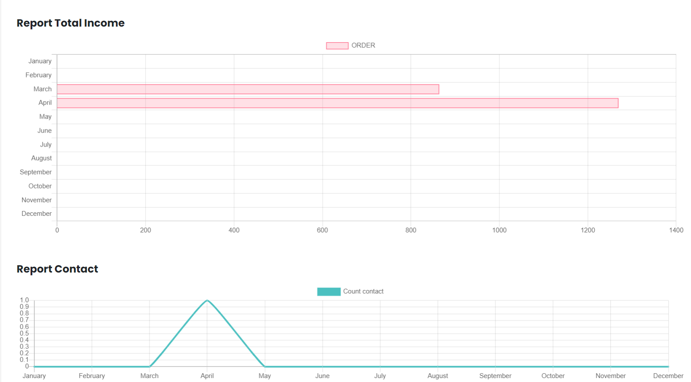

Slide 48
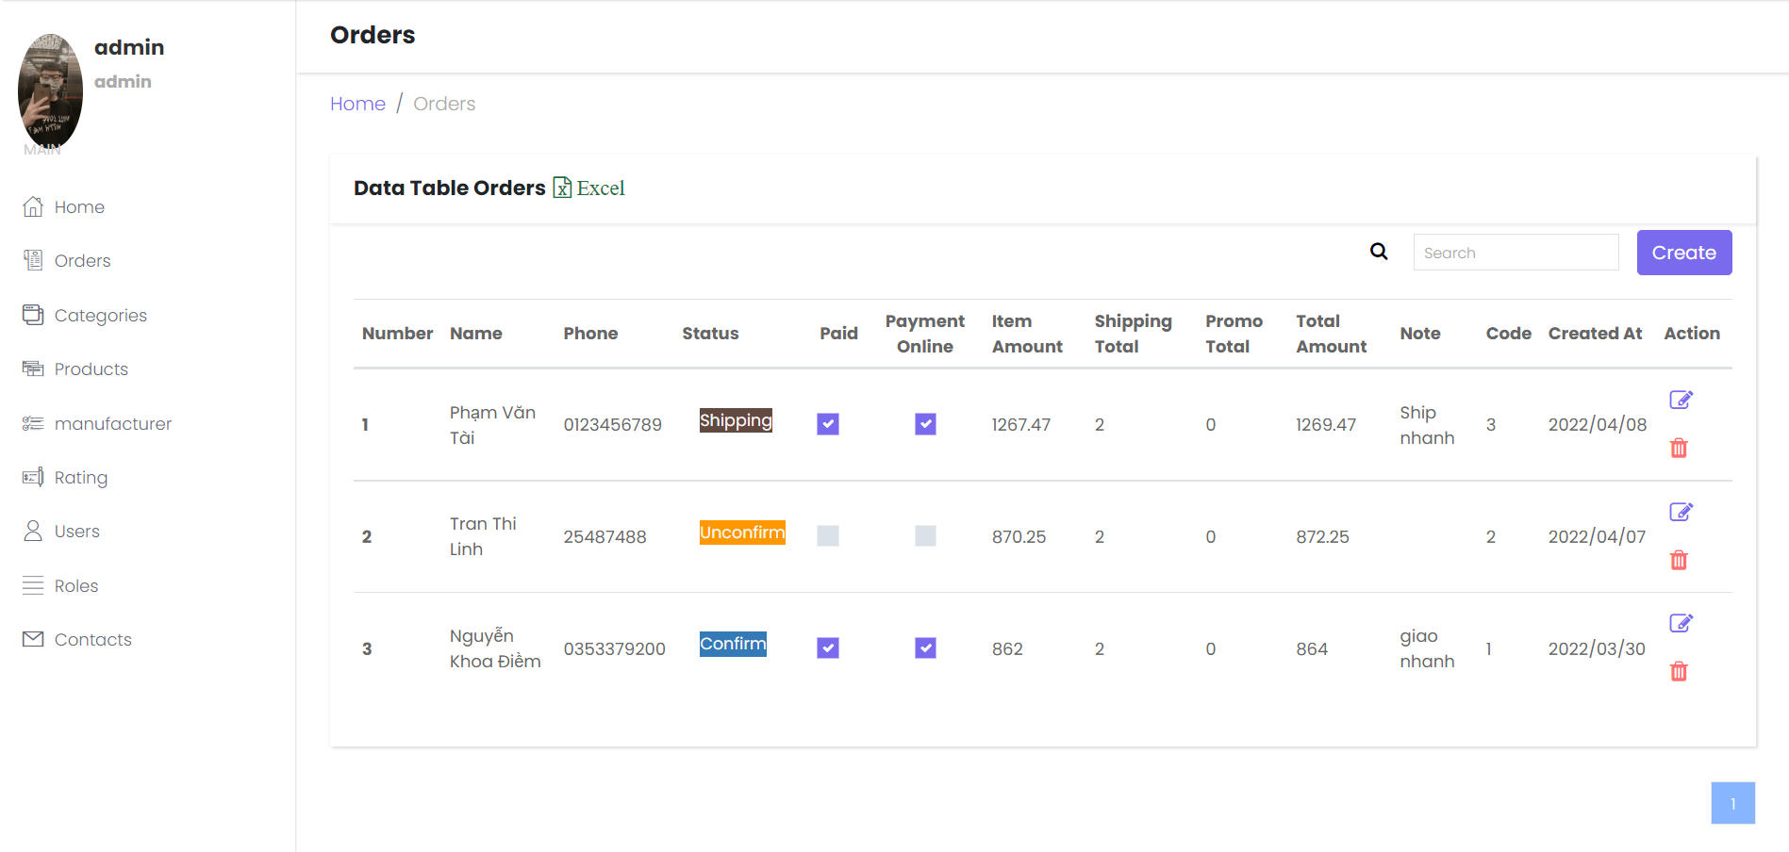
This is the Order page interface

Slide 49
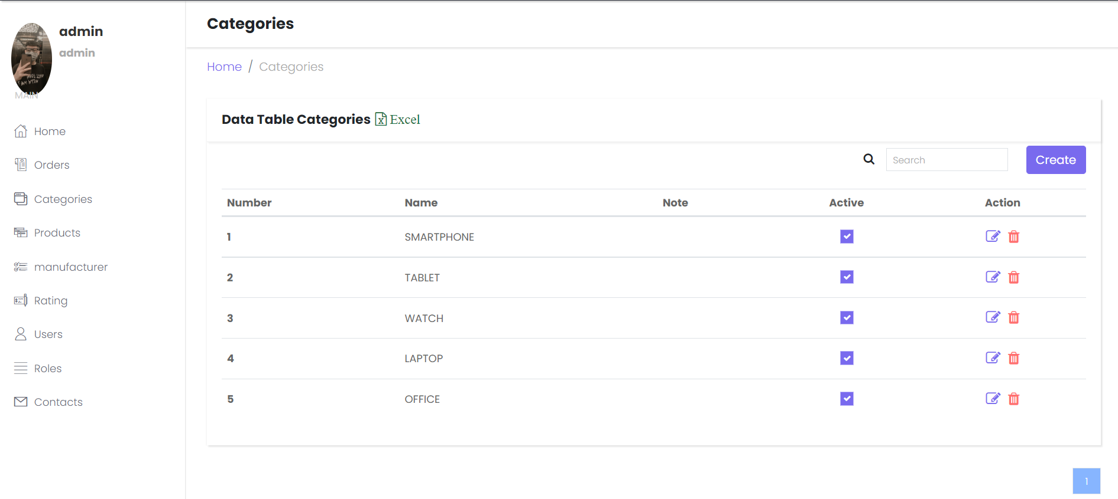
Categories page manages all the categories in the shop

Slide 50
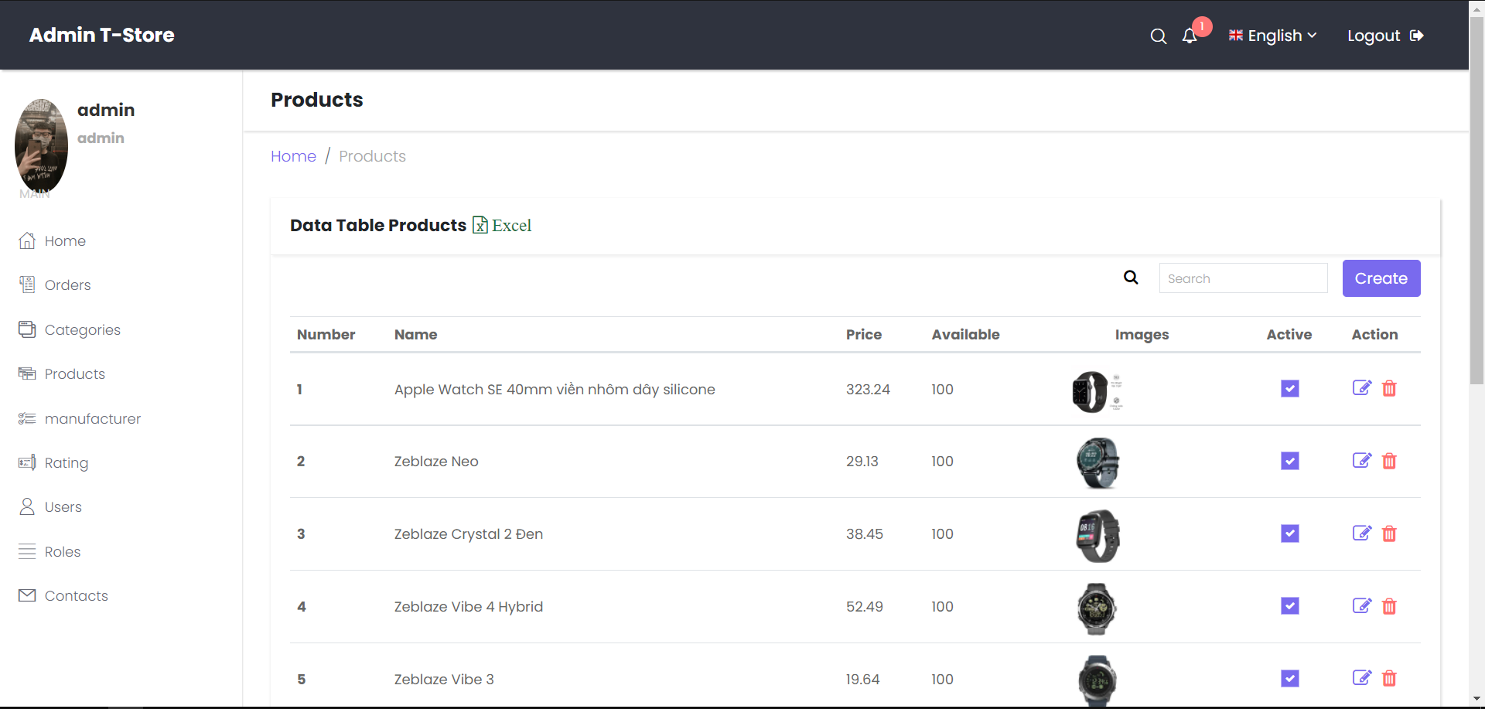
The products page manages all the products in the shop

Slide 51
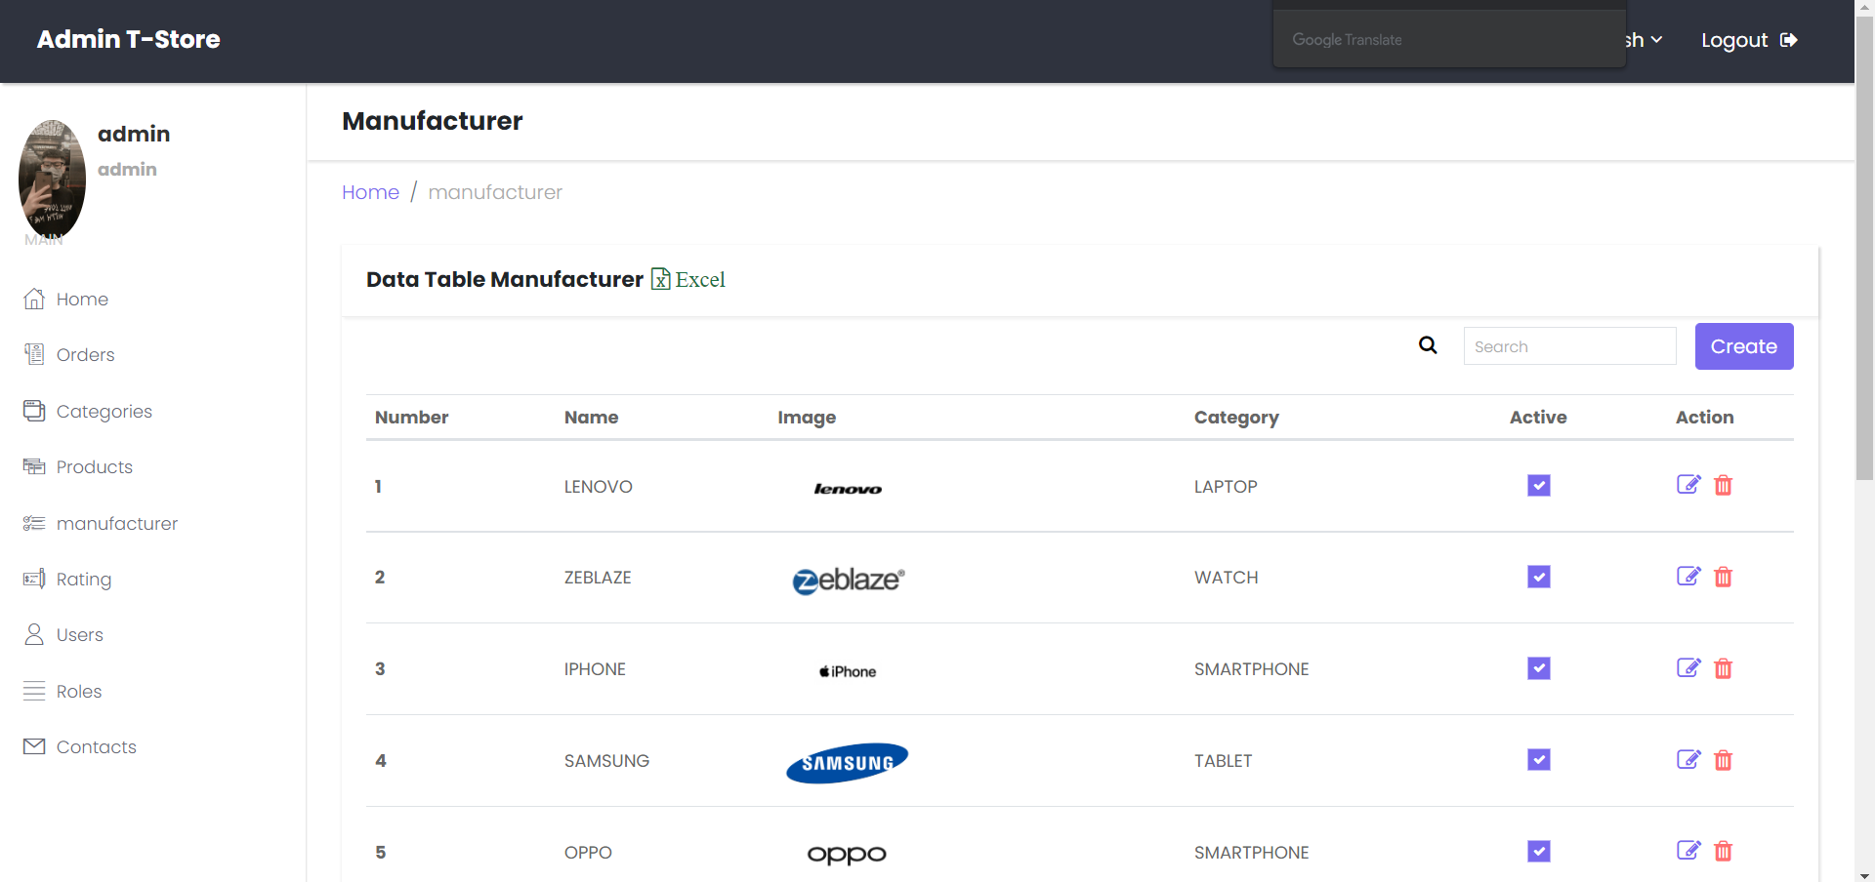
The Manufacturer page displays the brands that cooperate with the shop

Slide 52
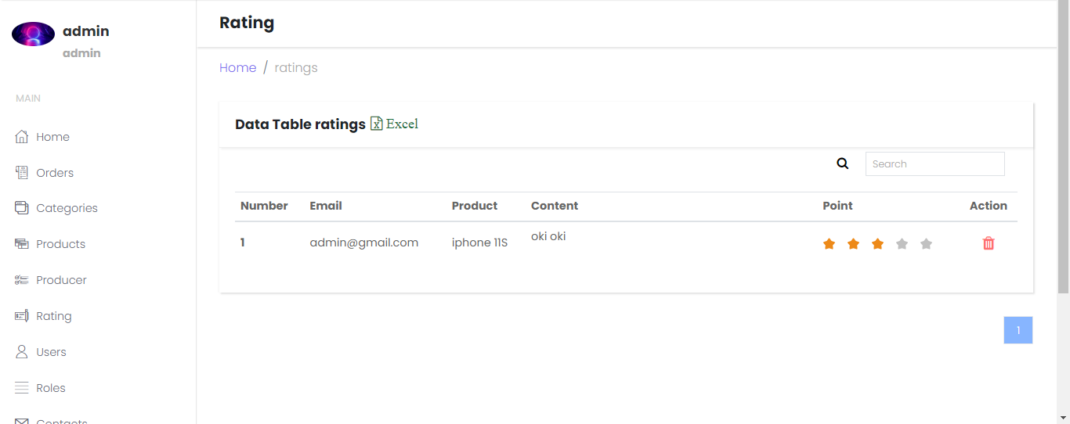

Slide 53
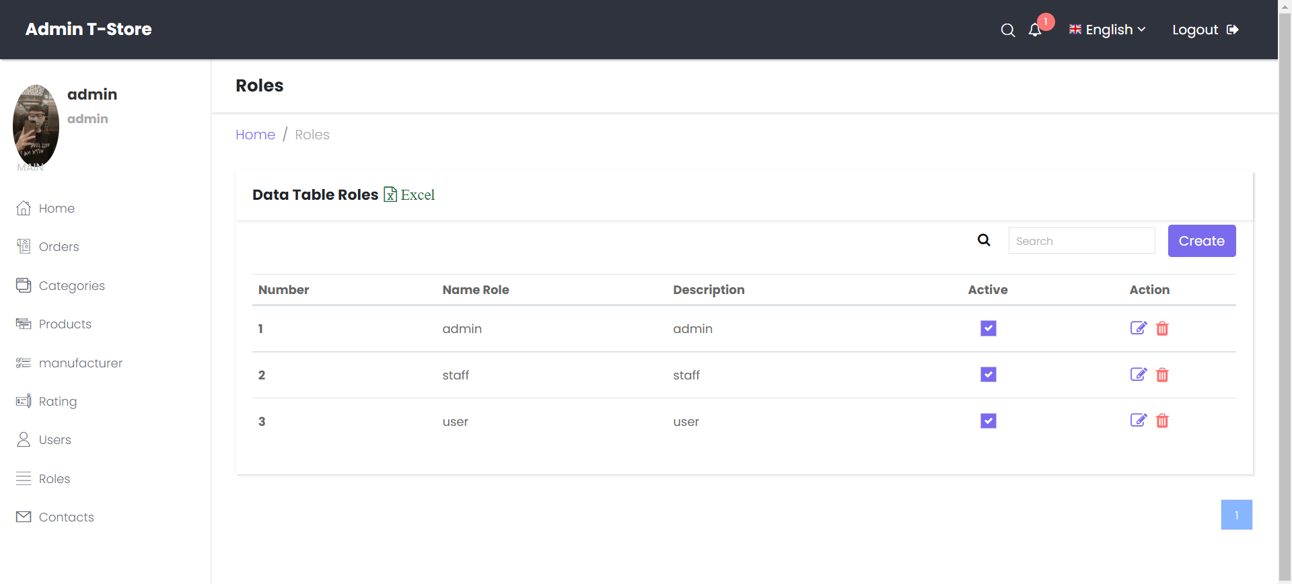
The roles page is where users, admins and staff are managed

Slide 54
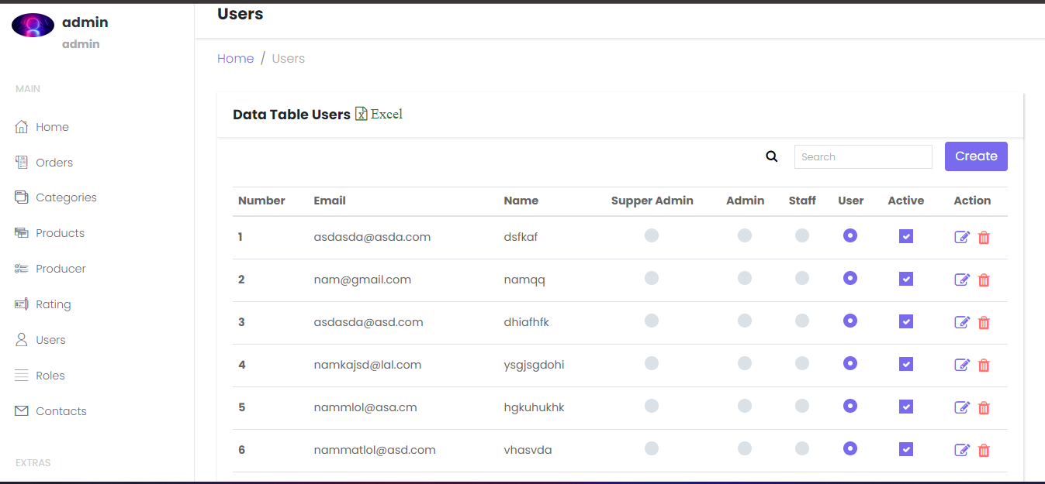

Slide 55
The roles page is where users, admins and staff are managed

Slide 56
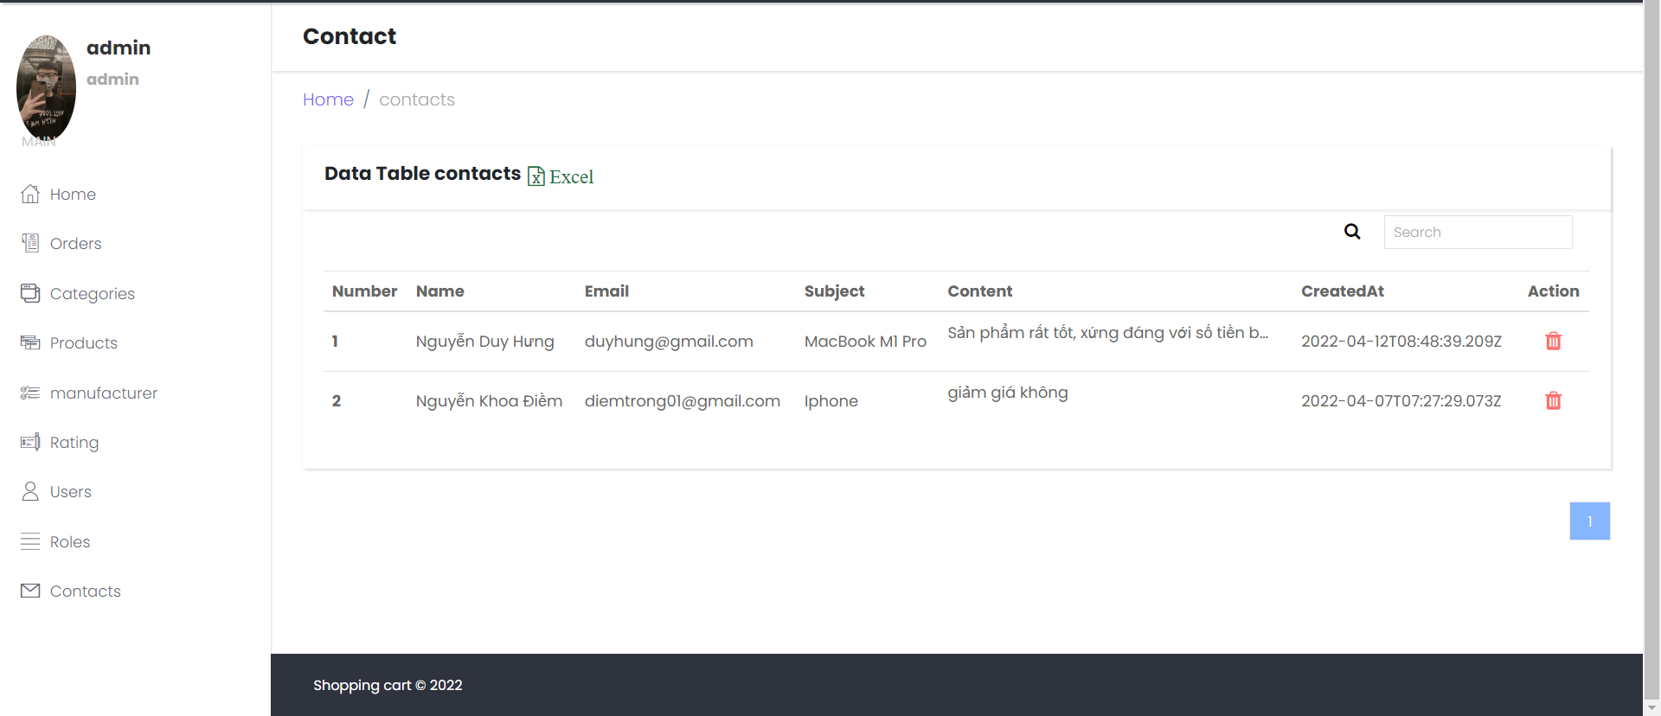
The contact page is the place to receive customer feedback about the products purchased in the shop

Slide 57
3. Test and upload website on heroku

Slide 58
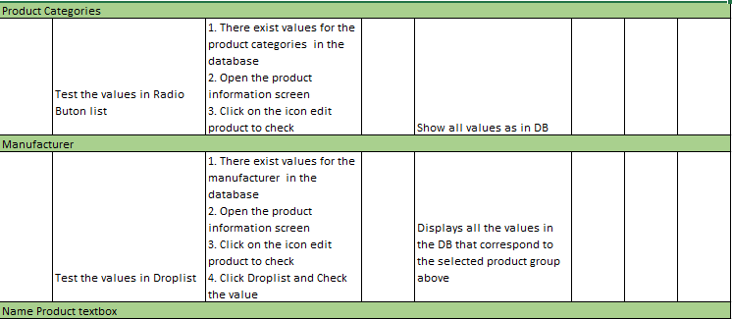
Product Information

Slide 59
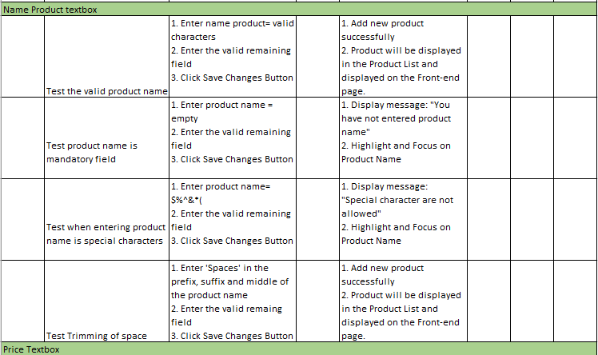

Slide 60
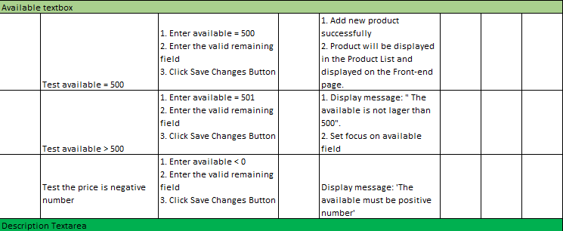

Slide 61
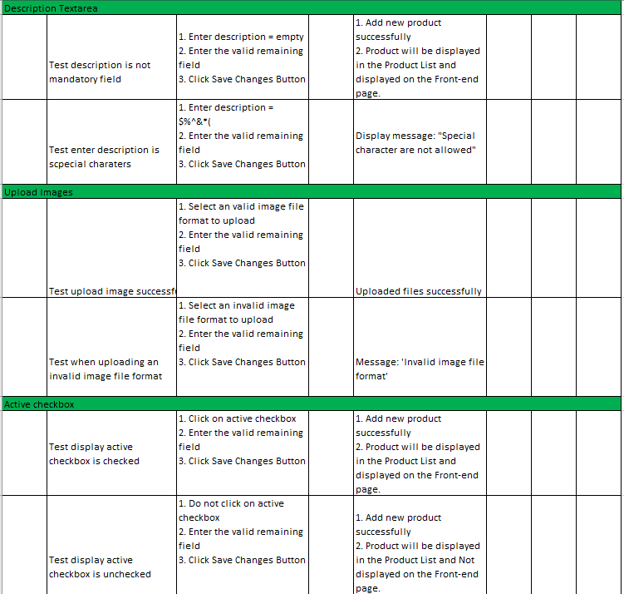

Slide 62
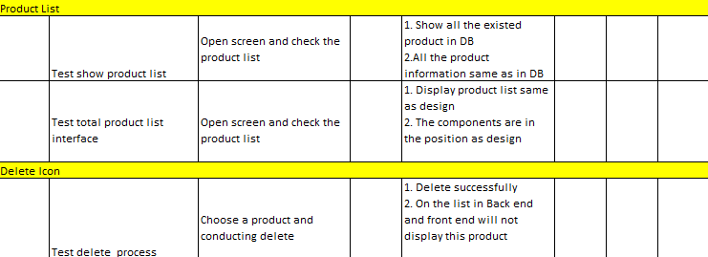

Slide 63
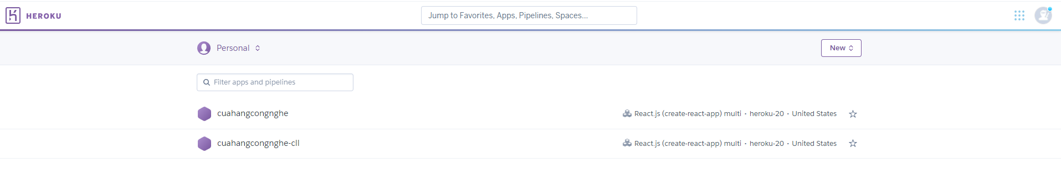
Deploy

Slide 64
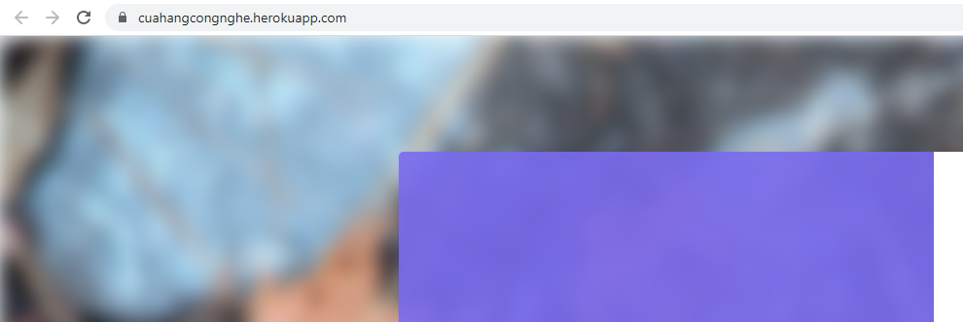
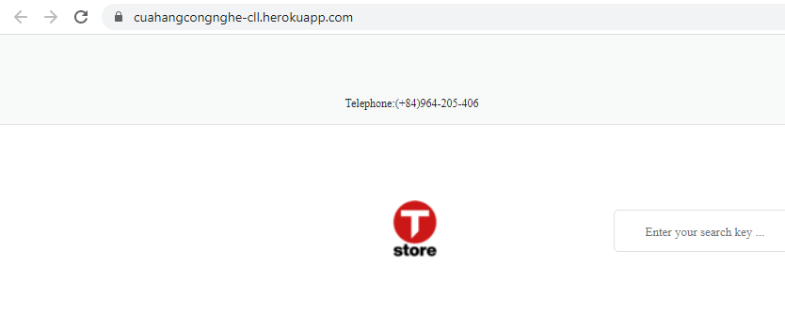

Slide 65
III. CONLUSION
1. Achieved
2. Not Good
3. Improvement in Future

Slide 66
Achieved
Understand the process and operations of online sales
Build a website to sell electronic devices with basic features
The actual website compared to the original Design is guaranteed 80%
Integrated online payment function through Paypal payment gateway

Slide 67
2. Not Good

Slide 68
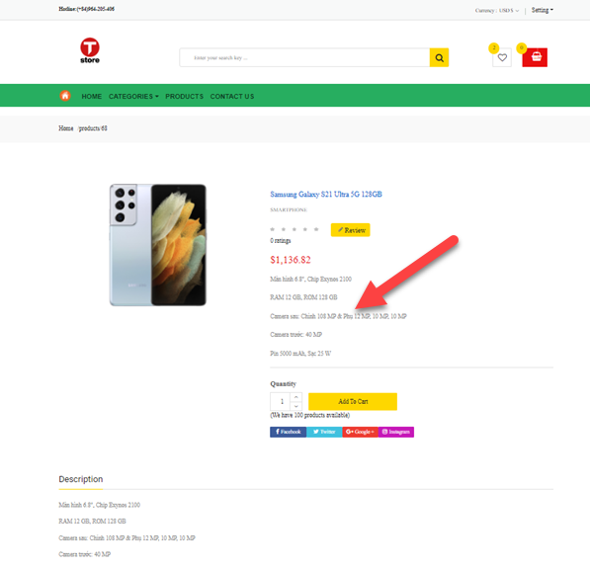

Design
Design
Actual

Slide 69
Design
Design
Actual

Slide 70


Design
Design
Actual

Slide 71


Design

Slide 72
Function
Forcing users to log in to purchase goods
Unfinished discount feature
Bank Transfer
Lack of buy now feature
Register function

Slide 73

Improvement in Future
Learn some more languages, and application software to improve the interface, optimize, and develop additional features missing in the current version.
Improve the website into a standard SEO website

Slide 74
Thanks for listening

